Slide 1
CENG-232 Logic Design
Week 4
Decoders, Multiplexers

Slide 2
Decoders
Two commonly used circuits: decoders and multiplexers.
Implementation of these serve as examples of the circuit analysis and design techniques.
They can be used to implement arbitrary functions.
They introduce us to abstraction and modularity as hardware design principles.
We’ll often use decoders and multiplexers as building blocks in designing more complex hardware.

Slide 3
What is a Decoder?
General idea: given a k bit input,
Detect which of the 2^{k} combinations is represented
Produce 2^{k} outputs, only one of which is “1”.

Slide 4
What does a decoder do?
A n-to-2^{n} decoder takes an n-bit input and produces 2^{n} outputs. The n inputs represent a binary number that determines which of the 2^{n} outputs is uniquely true.
A 2-to-4 decoder operates according to the following truth table.
The 2-bit input is called S1 S0, and the four outputs are Q0-Q3.
If the input is the binary number i, then output Qi is uniquely true.
For instance, if the input S1 S0 = 10 (decimal 2), then output Q2 is true, and Q0, Q1, Q3 are all false.
This circuit “decodes” a binary number into a “one-of-four” code.

Slide 5
How can you build a 2-to-4 decoder?
Follow the design procedures!
We have a truth table, so we can write equations for each of the four outputs (Q0-Q3), based on the two inputs (S0-S1).
In this case there’s not much to be simplified.
Q0 = S1’ S0’
Q1 = S1’ S0
Q2 = S1 S0’
Q3 = S1 S0

Slide 6
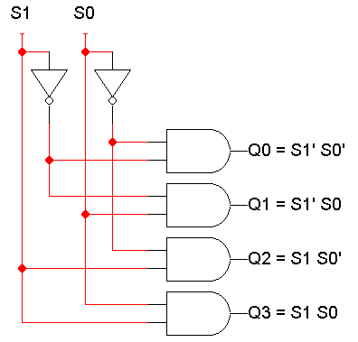
A picture of a 2-to-4 decoder
Q0 = S1’ S0’
Q1 = S1’ S0
Q2 = S1 S0’
Q3 = S1 S0

Slide 7
Enable inputs
Many devices have an additional enable input, which is used to “activate” or “deactivate” the device.
For a decoder,
EN=1 activates the decoder, so it behaves as specified earlier. Exactly one of the outputs will be 1.
EN=0 “deactivates” the decoder. By convention, that means all of the decoder’s outputs are 0.
We can include this additional input in the decoder’s truth table:

Slide 8
An aside: abbreviated truth tables
In this table, note that whenever EN=0, the outputs are always 0, regardless of inputs S1 and S0.
We can abbreviate the table by writing x’s in the input columns for S1 and S0.

Slide 9
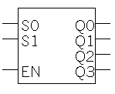
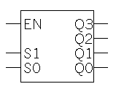
Blocks and Abstraction
Decoders are common enough that we want to encapsulate them and treat them as an individual entity.
Block diagrams for 2-to-4 decoders are shown here. The names of the inputs and outputs, not their order, is what matters.
Q0 = S1’ S0’
Q1 = S1’ S0
Q2 = S1 S0’
Q3 = S1 S0

Slide 10
Abstraction
A decoder block provides abstraction:
You can use the decoder as long as you know its truth table or equations, without knowing exactly what’s inside.
It makes diagrams simpler by hiding the internal circuitry.
It simplifies hardware reuse. You don’t have to keep rebuilding the decoder from scratch every time you need it.
These blocks are like functions in programming!

Slide 11
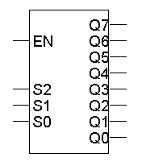
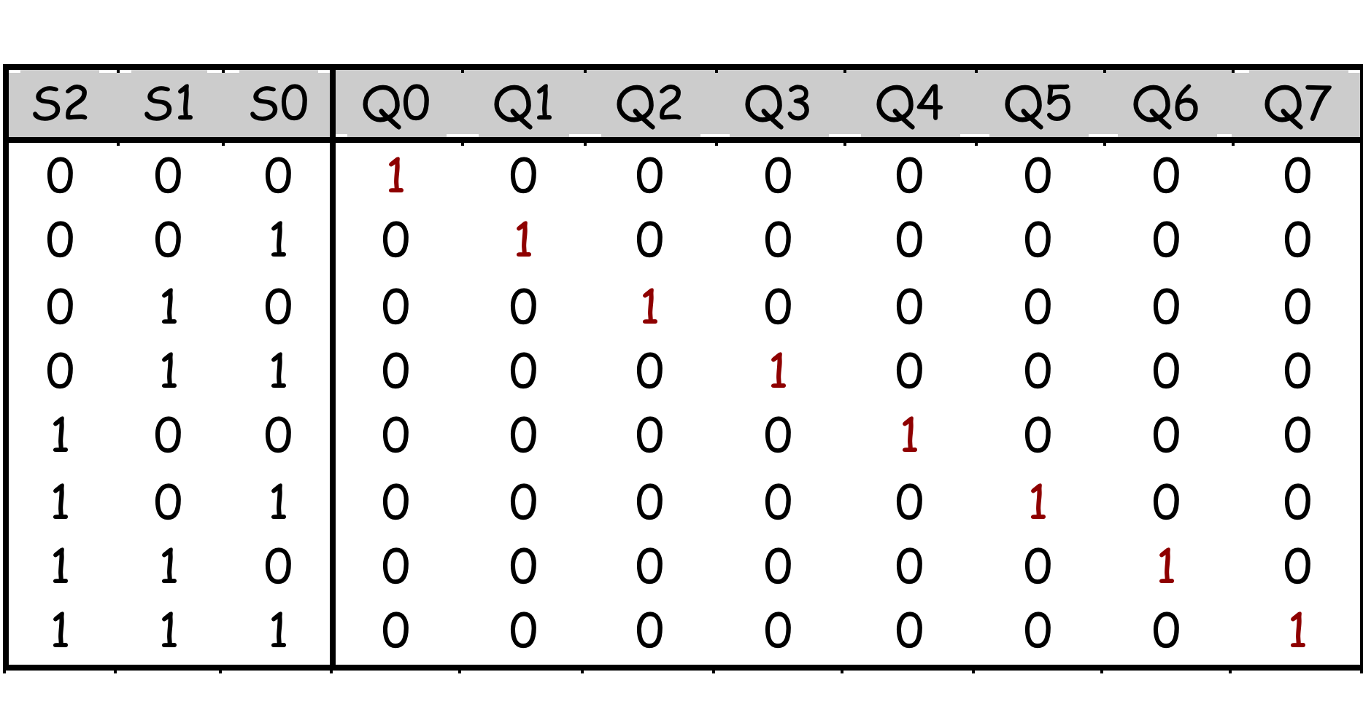
A 3-to-8 decoder
Larger decoders are similar. Here is a 3-to-8 decoder.
The block symbol is on the right.
A truth table (without EN) is below.
Output equations are at the bottom right.
Again, only one output is true for any input combination.
Q0 = S2’ S1’ S0’
Q1 = S2’ S1’ S0
Q2 = S2’ S1 S0’
Q3 = S2’ S1 S0
Q4 = S2 S1’ S0’
Q5 = S2 S1’ S0
Q6 = S2 S1 S0’
Q7 = S2 S1 S0

Slide 12
So what is a decoder good for?
Remember the definition of “minterm”:
“AND”ed product of literals in which each variable appears exactly once, in true or complemented form (but not both!)
Each minterm has exactly one ‘1’ in the truth table
When minterms are ORed together each minterm contributes a ‘1’ to the final function

Slide 13
So what is a decoder good for?
Do the truth table and equations look familiar?
Decoders are sometimes called minterm generators.
For each of the input combinations, exactly one output is true.
Each output equation contains all of the input variables.
These properties hold for all sizes of decoders.
This means that you can implement arbitrary functions with decoders.
If you have a sum of minterms equation for a function, you can easily use a decoder (a minterm generator) to implement that function.
Q0 = S1’ S0’
Q1 = S1’ S0
Q2 = S1 S0’
Q3 = S1 S0

Slide 14
Design example: “Addition”
Let’s make a circuit that adds three 1-bit inputs X, Y and Z.
We will need two bits to represent the total; let’s call them C and S, for “carry” and “sum” Note that C and S are two separate functions of the same inputs X, Y and Z.
Here is the truth table.
C(X,Y,Z) = Σ m(3,5,6,7)
S(X,Y,Z) = Σ m(1,2,4,7)
0 + 1 + 1 = 10
1 + 1 + 1 = 11

Slide 15
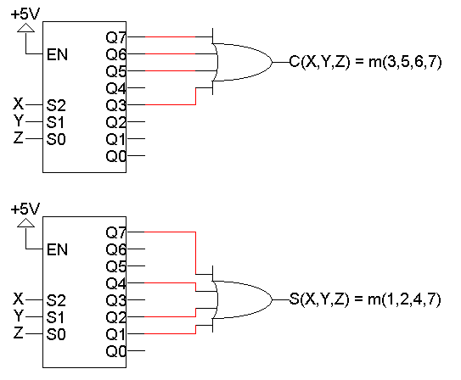
Decoder-based “Adder”
Here, two 3-to-8 decoders implement C and S as sums of minterms.
C (X,Y,Z) = Σ m(3,5,6,7)
S (X,Y,Z) = Σ m(1,2,4,7)

Slide 16
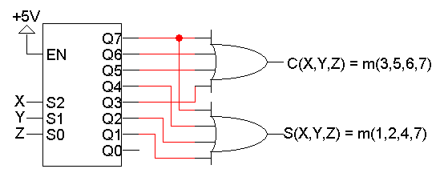
Using just one decoder
Since the two functions C and S both have the same inputs, we could use just one decoder instead of two.
C (X,Y,Z) = Σ m(3,5,6,7)
S (X,Y,Z) = Σ m(1,2,4,7)

Slide 17
Building a 3-to-8 decoder
You could build a 3-to-8 decoder directly from the truth table and equations below, just like how we built the 2-to-4 decoder.
Another way to design a decoder is to break it into smaller pieces.
Notice some patterns in the table below:
When S2 = 0, outputs Q0-Q3 are generated as in a 2-to-4 decoder.
When S2 = 1, outputs Q4-Q7 are generated as in a 2-to-4 decoder.
Q0 = S2’ S1’ S0’ = m₀
Q1 = S2’ S1’ S0 = m₁
Q2 = S2’ S1 S0’ = m₂
Q3 = S2’ S1 S0 = m₃
Q4 = S2 S1’ S0’ = m₄
Q5 = S2 S1’ S0 = m₅
Q6 = S2 S1 S0’ = m₆
Q7 = S2 S1 S0 = m₇

Slide 18
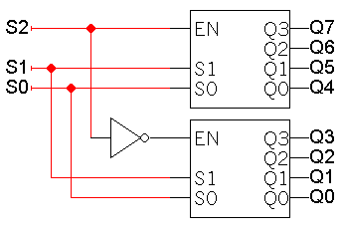
Decoder Expansion
You can use enable inputs to use decoders together. Here’s a 3-to-8 decoder constructed from two 2-to-4 decoders:

Slide 19
Modularity
Be careful not to confuse the “inner” inputs and outputs of the 2-to-4 decoders with the “outer” inputs and outputs of the 3-to-8 decoder (which are in boldface).
This is similar to having several functions in a program which all use a formal parameter “x”
You could verify that this circuit is a 3-to-8 decoder, by using equations for the 2-to-4 decoders to derive equations for the 3-to-8.

Slide 20
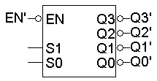
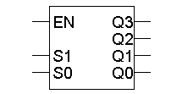
A variation of the standard decoder
The decoders we’ve seen so far are active-high decoders.
An active-low decoder is the same thing, but with an inverted EN input and inverted outputs.

Slide 21
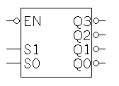
The difference?
Active-high decoders generate minterms, as we’ve already seen.
The output equations for an active-low decoder are mysteriously similar, yet somehow different.
It turns out that active-low decoders generate maxterms.
Q3 = S1 S0
Q2 = S1 S0’
Q1 = S1’ S0
Q0 = S1’ S0’
Q3’ = (S1 S0)’ = S1’ + S0’
Q2’ = (S1 S0’)’ = S1’ + S0
Q1’ = (S1’ S0)’ = S1 + S0’
Q0’ = (S1’ S0’)’ = S1 + S0

Slide 22
The difference?
Active-high decoders generate minterms, as we’ve already seen.
Active-low decoders generate maxterms.
Q3 = S1 S0
Q2 = S1 S0’
Q1 = S1’ S0
Q0 = S1’ S0’
Q3’ = (S1 S0)’ = S1’ + S0’
Q2’ = (S1 S0’)’ = S1’ + S0
Q1’ = (S1’ S0)’ = S1 + S0’
Q0’ = (S1’ S0’)’ = S1 + S0

Slide 23
Product of maxterms form
Every function can be written as a unique product of maxterms:
Only AND (product) operations occur at the “outermost” level.
Each term must be maxterm.
If you have a truth table for a function, you can write a product of maxterms expression by picking out the rows of the table where the function output is 0.
f = M₄ M₅ M₇
= ∏M(4,5,7)
= (x’ + y + z)(x’ + y + z’)(x’ + y’ + z’)
f’ = M₀ M₁ M₂ M₃ M₆
= ∏M(0,1,2,3,6)
= (x + y + z)(x + y + z’)(x + y’ + z)
(x + y’ + z’)(x’ + y’ + z)
f’ contains all the maxterms not in f.

Slide 24
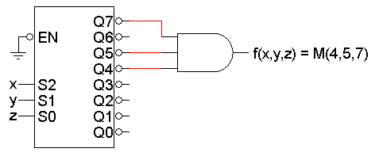
Active-low decoder example
So we can use active-low decoders to implement arbitrary functions too, but as a product of maxterms.
For example, here is an implementation of the function from the previous page
f (x,y,z) = ΠM (4,5,7), using an active-low decoder.
The “ground” symbol connected to EN represents logical 0, so this decoder is always enabled.
Remember that you need an AND gate for a product of sums.

Slide 25
Converting between standard forms
We can easily convert a sum of minterms to a product of maxterms.
The easy way is to replace minterms with maxterms, using maxterm numbers that don’t appear in the sum of minterms:
The same thing works for converting in the opposite direction, from a product of maxterms to a sum of minterms.
f = Σm(0,1,2,3,6)
f’ = Σm(4,5,7) -- f’ contains all the minterms not in f
= m₄ + m₅ + m₇
(f’)’ = (m₄ + m₅ + m₇)’ -- complementing both sides
f = m₄’ m₅’ m₇’ -- DeMorgan’s law
= M₄ M₅ M₇ -- from the previous page
= ∏M(4,5,7)
F = Σm(0,1,2,3,6)
= ∏M(4,5,7)

Slide 26
Summary
A n-to-2^{n} decoder generates the minterms of an n-variable function.
As such, decoders can be used to implement arbitrary functions.
Later on we’ll see other uses for decoders too.
Some variations of the basic decoder include:
Adding an enable input.
Using active-low inputs and outputs to generate maxterms.
We also talked about:
Applying our circuit analysis and design techniques to understand and work with decoders.
Using block symbols to encapsulate common circuits.
Building larger decoders from smaller ones.

Slide 27
Multiplexers / Demultiplexers
Acknowledgement: Most of the following slides are adapted from Prof. Kale's slides at UIUC, USA.

Slide 28




In the good old times …
Multiplexers, or “muxes”, are used to choose between resources.
A real-life example: in the old days before networking, several computers could share one printer through the use of a switch.

Slide 29
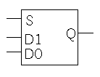
Multiplexers
A 2^{n}-to-1 multiplexer sends one of 2^{n} input lines to a single output line.
A multiplexer has two sets of inputs:
2^{n} data input lines
S select lines, to pick one of the 2^{n} data inputs
The mux output is a single bit, which is one of the 2^{n} data inputs.
The simplest example is a 2-to-1 mux:
The select bit S controls which of the data bits D0-D1 is chosen:
If S=0, then D0 is the output (Q=D0).
If S=1, then D1 is the output (Q=D1).
Q = S’ D₀ + S D₁

Slide 30
More truth table abbreviations
Here is a full truth table for this 2-to-1 mux, based on the equation on the right:
Another kind of abbreviated truth table.
Input variables appear in the output.
This table implies that when S=0, the output Q=D0, and when S=1 the output Q=D1.
Q = S’ D₀ + S D₁

Slide 31
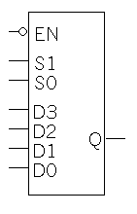
A 4-to-1 multiplexer
Here is a block diagram and abbreviated truth table for a 4-to-1 mux.
Q = S₁’ S₀’ D₀ + S₁’ S₀ D₁ + S₁ S₀’ D₂ + S₁ S₀ D₃
How would you include EN in Q?

Slide 32
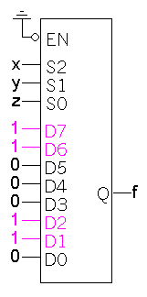
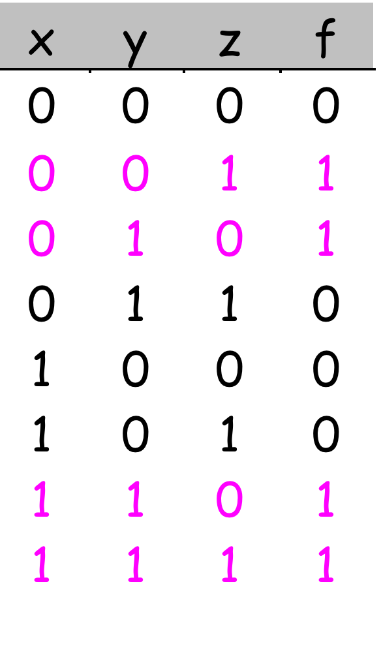
Functions with multiplexers
Muxes can be used to implement arbitrary functions.
One way to implement a function of n variables is to use an 2^{n}-to-1 mux:
For each minterm m_{i} of the function, connect 1 to mux data input D_{i}. Each input corresponds to one row of the truth table.
Connect the function’s input variables to the mux select (S) inputs. These are used to indicate a particular input combination.
For example, let’s look at
f (x,y,z) = Σm (1,2,6,7).

Slide 33
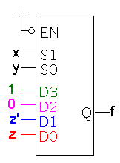
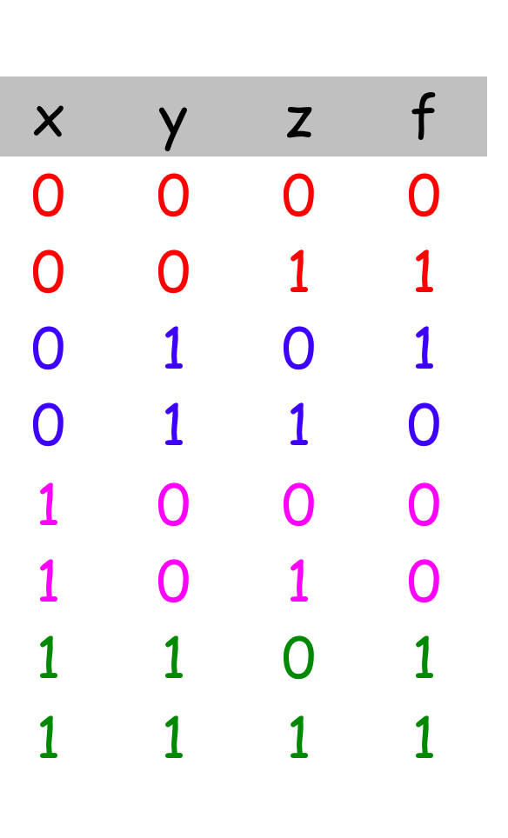
A more efficient way
We can actually implement f(x,y,z) = Σ m(1,2,6,7) with just a 4-to-1 mux, instead of an 8-to-1.
Step 1: Find the truth table for the function, and group the rows into pairs. Within each pair of rows, x and y are the same, so f is a function of z only.
When xy=00, f=z
When xy=01, f=z’
When xy=10, f=0
When xy=11, f=1
Step 2: Connect the first two input variables of the truth table (here, x and y) to the select bits S1 S0 of the 4-to-1 mux.
Step 3: Connect the equations above for f(z) to the data inputs D0-D3.

Slide 34
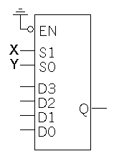
Example: Multiplexer “adder”
Let’s implement the adder carry function, C (X,Y,Z), with muxes.
There are three inputs, so we’ll need a 4-to-1 mux.
The basic setup is to connect two of the input variables (usually the first two in the truth table) to the mux select inputs.
With S₁=X and S₀=Y, then
Q = X’Y’D₀ + X’YD₁ + XY’D₂ + XYD₃
Equation for the multiplexer

Slide 35
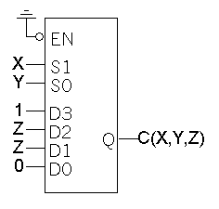
Multiplexer-based carry
We can set the multiplexer data inputs D0-D3, by fixing X and Y and finding equations for C in terms of just Z.
When XY=00, C=0
When XY=01, C=Z
When XY=10, C=Z
When XY=11, C=1
C = X’ Y’ D₀ + X’ Y D₁ + X Y’ D₂ + X Y D₃
= X’ Y’ 0 + X’ Y Z + X Y’ Z + X Y 1
= X’ Y Z + X Y’ Z + XY
= Σm(3,5,6,7)

Slide 36
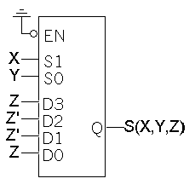
Multiplexer-based sum
Here’s the same thing, but for the sum function S(X,Y,Z).
When XY=00, S=Z
When XY=01, S=Z’
When XY=10, S=Z’
When XY=11, S=Z
S = X’ Y’ D₀ + X’ Y D₁ + X Y’ D₂ + X Y D₃
= X’ Y’ Z + X’ Y Z’ + X Y’ Z’ + X Y Z
= Σm(1,2,4,7)

Slide 37
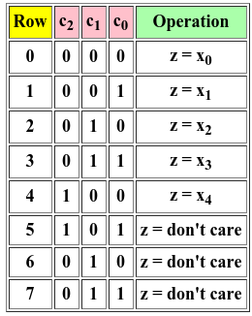
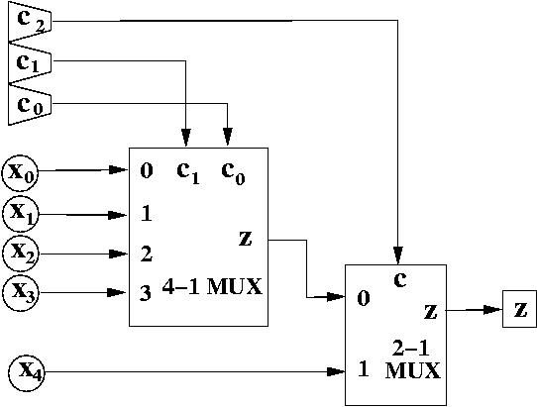
Mux’es as building blocks
How can we implement a 5-to-1 mux using a 4-to-1 mux and a 2-to-1 mux?
Example from https://www.cs.umd.edu/class/sum2003/cmsc311/Notes/Comb/5_1mux.html

Slide 38
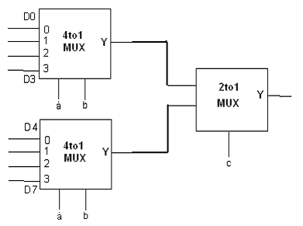
Mux’es as building blocks
How can we implement a 8-to-1 mux using smaller muxes?

Slide 39
Summary
A 2^{n}-to-1 multiplexer routes one of 2^{n} input lines to a single output line.
Just like decoders,
Muxes are common enough to be supplied as stand-alone devices for use in modular designs.
Muxes can implement arbitrary functions.
We saw some variations of the standard multiplexer:
Smaller muxes can be combined to produce larger ones.
We can add active-low or active-high enable inputs.
As always, we use truth tables and Boolean algebra to analyse circuits and expressions.

